Slide 1
Familiarize yourself with phishing attacks
Human Resources and Marketing

Slide 2
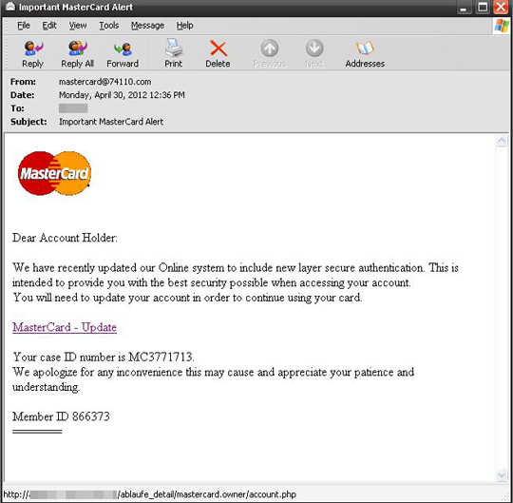
What is phishing?
Phishing is a type of cyber attack where malicious individuals or groups pretend to be trustworthy entities, such as banks, companies, or colleagues, to trick you into revealing sensitive information or performing actions that can harm you or the organization. These attacks often come through email, messages, or websites that look legitimate, but they aim to deceive you into sharing passwords, credit card numbers, or other confidential data. It's important to be cautious, verify the authenticity of requests, and report any suspicious activity to protect yourself and the organization from potential harm.

Slide 3
Learn to spot phishing emails
Spoofed Sender: Phishing emails imitate well-known companies or trusted individuals, using similar email addresses or slightly altered domain names.
Urgency and Fear: Attackers create a sense of urgency or fear, pressuring recipients into immediate action by claiming account closures or impending consequences.
Suspicious URLs and Links: Phishing emails contain deceptive links that appear legitimate but redirect to malicious websites aimed at stealing sensitive information. Hover over links to verify their destination before clicking.

Slide 4
How do we stop getting phished?
Verify Email ID: Check if the sender's email matches the official format.
Review Format and Grammar: Look for proper formatting and grammar in emails.
Confirm Suspicious Links: Check with the respective department before clicking on any links.
Look for Legitimate Information: Be cautious of emails containing expiration dates, time-sensitive notices, or phishing disclaimers.
Stay Informed and Educated: Keep up with the latest phishing techniques and participate in security awareness training.

